Slide 1
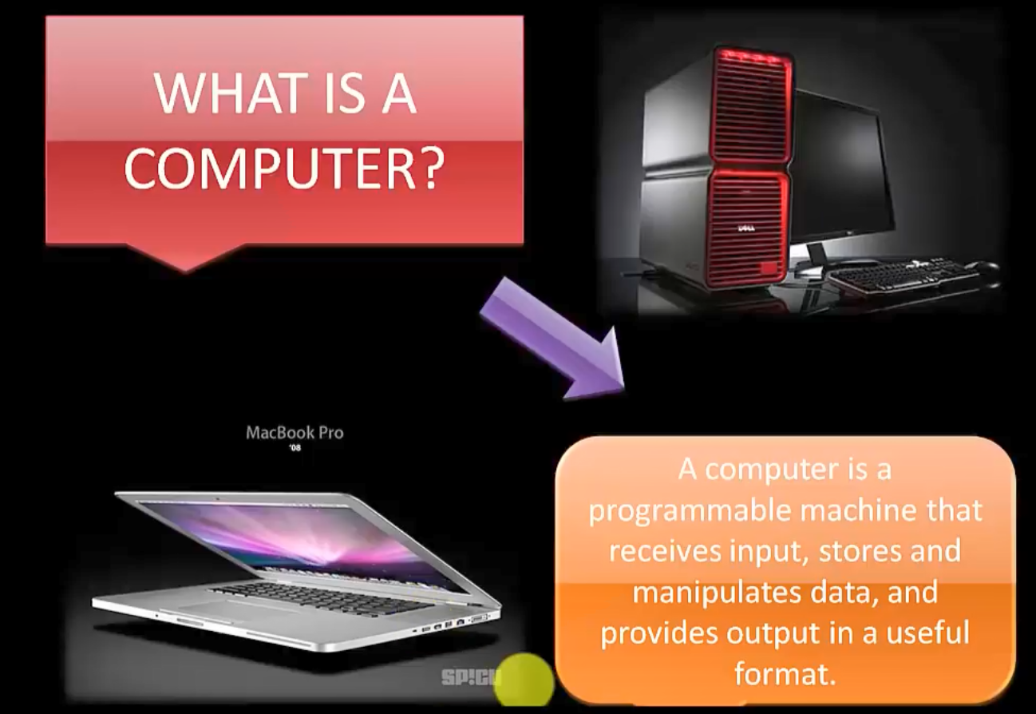

Slide 2
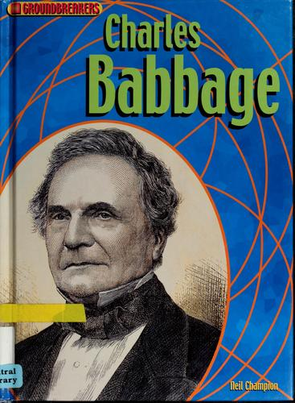
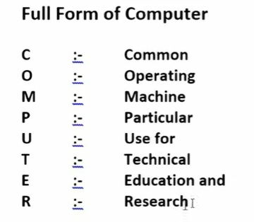

Slide 3
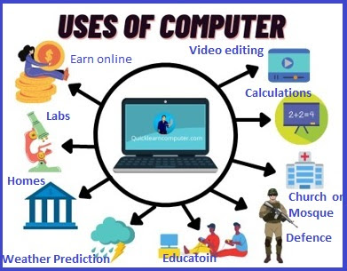
USES OF COMPUTER
Uses of Computer for Storing Important Data
Uses of Computer in Education System
Uses of the computer to communicate with people
Uses of computer for defence purpose
Uses of a computer in office work
Uses of Computer in Science and Technology
Uses of Computer for Training purposes
Uses of Computer for E-Learning
Uses of the computer in Medical Science
Uses of computer for Entertainment purposes
Uses of Computer for marketing purposes
Uses of the computer for managing banks
Uses of the computer for office automation
Uses of a computer to browse webs and internet

Slide 4
Uses of the computer for video conferences
Uses of the computer to manage the stock exchange
Uses of computer for Press and publishing
Uses of computers in Government sectors
Uses of computer in Sports
Uses of computer in business

Slide 5
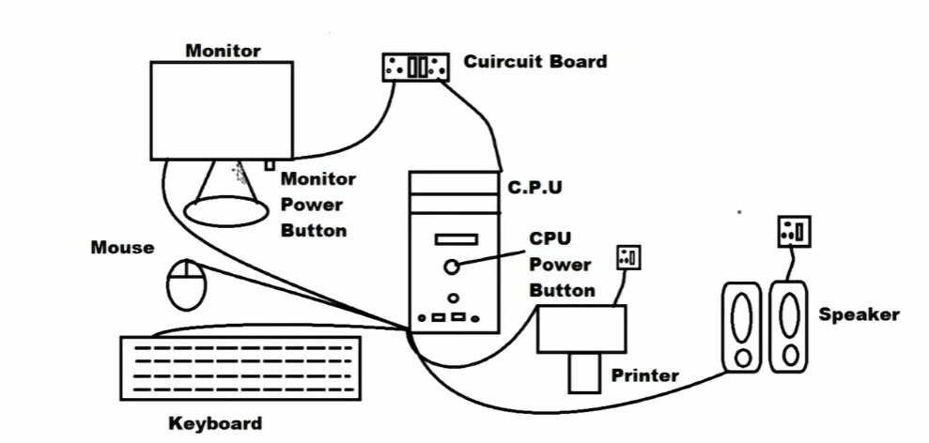
Basic Structure of Computer

Slide 6
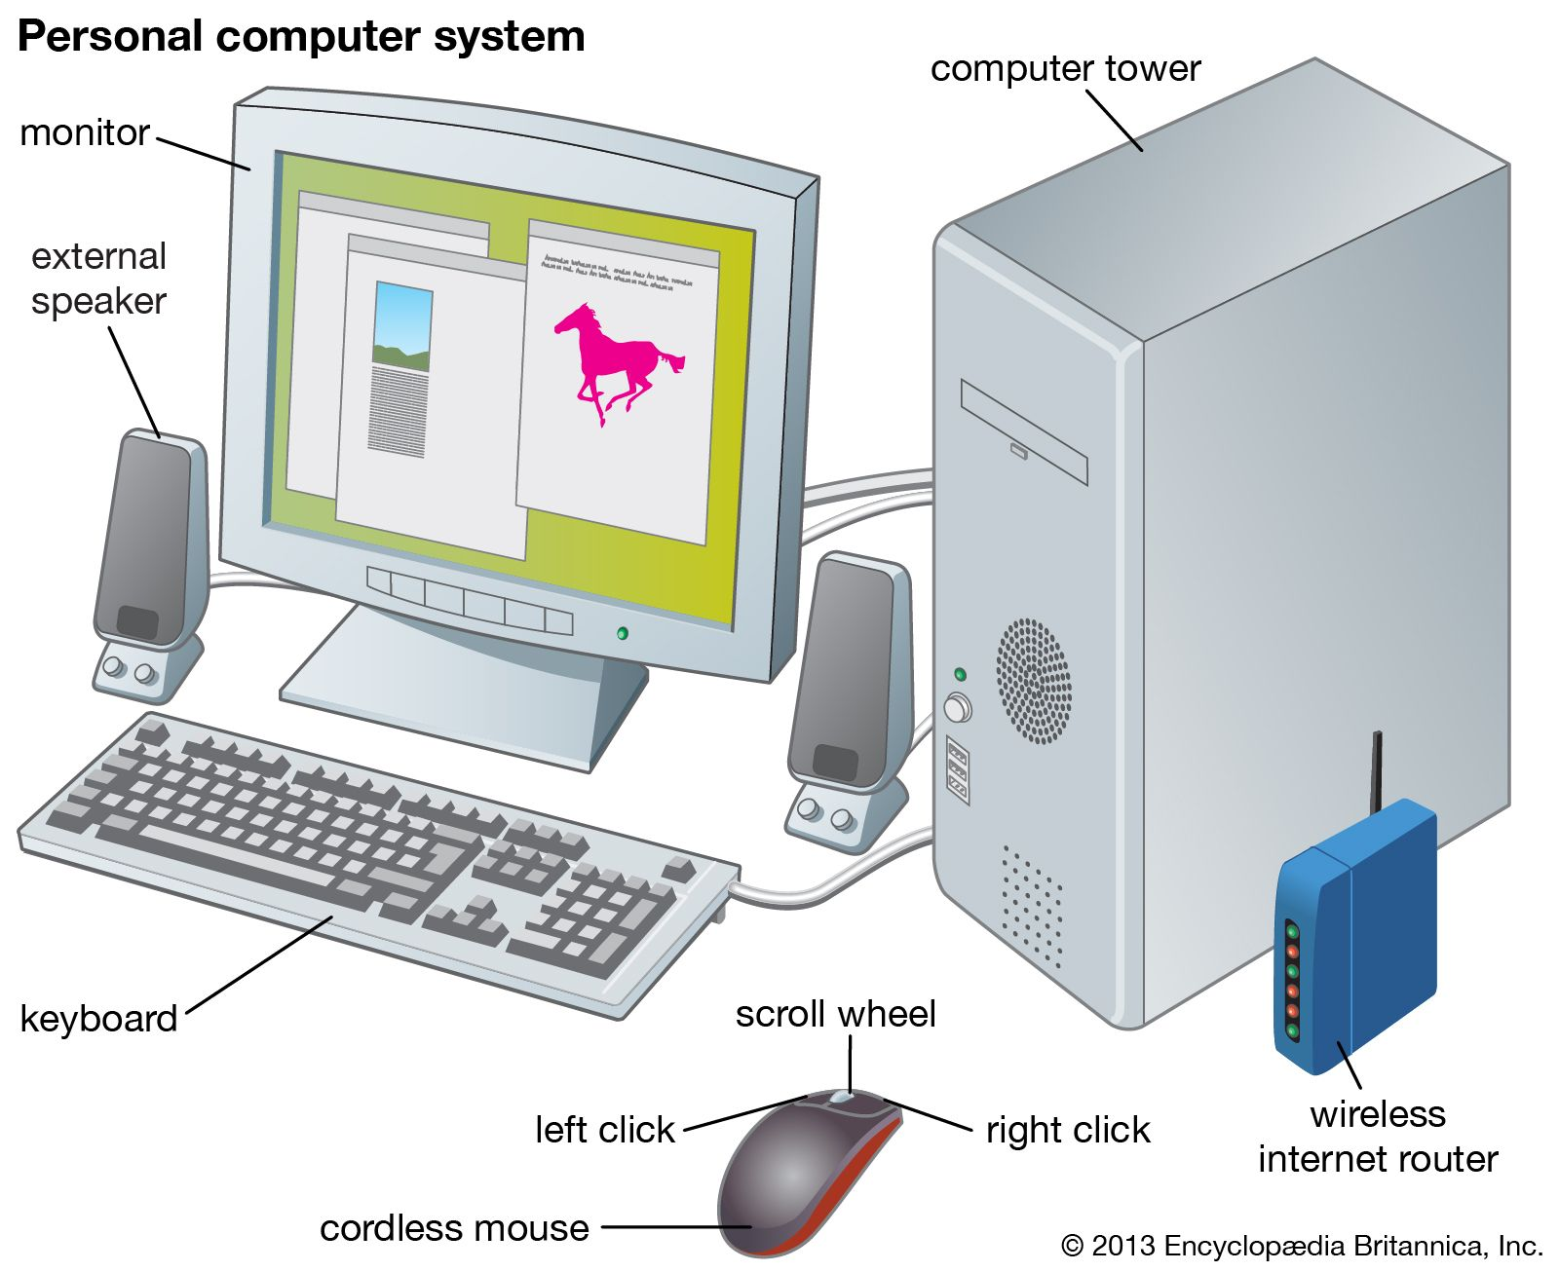

Slide 7
Generation of Computer
Frist Generation
Second Generation
Third Generation
Fourth Generation
Fifth Generation

Slide 8
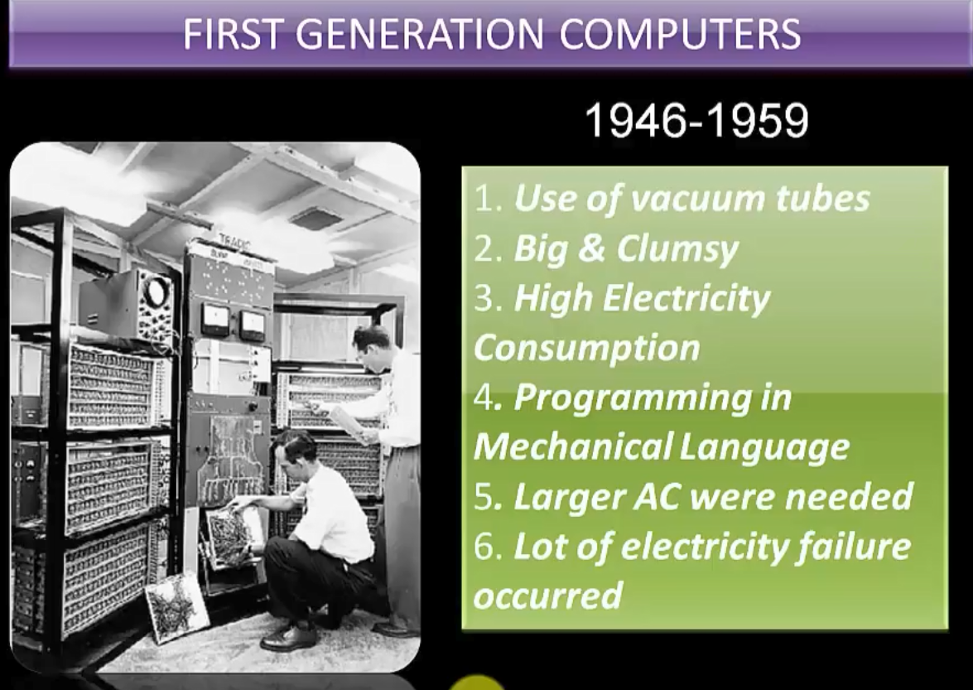

Slide 9
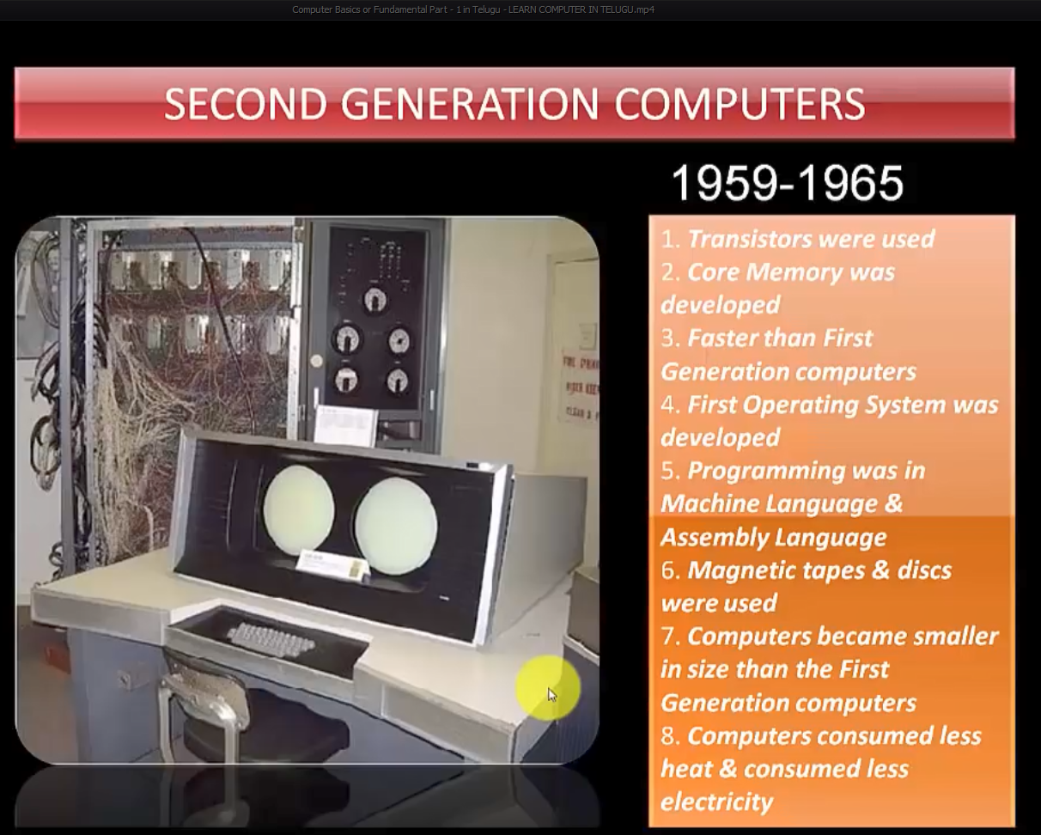

Slide 10
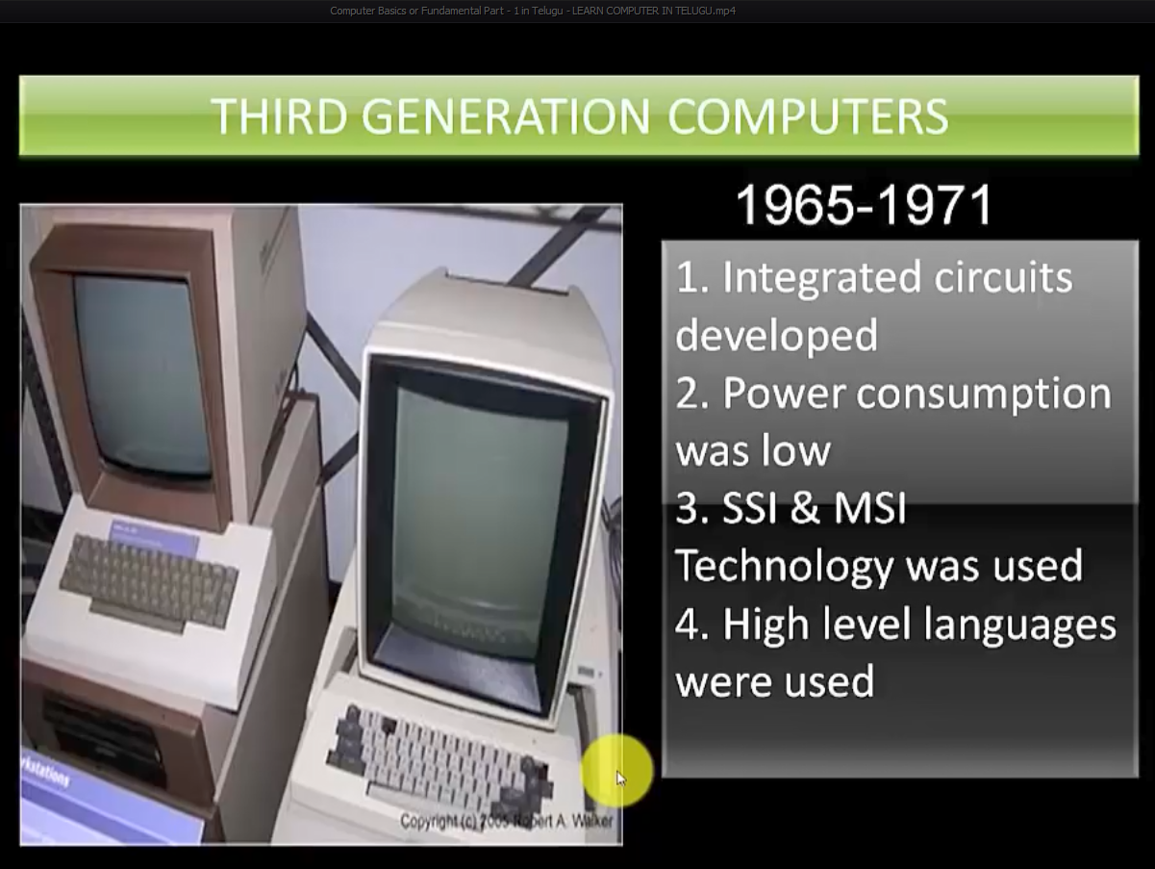

Slide 11
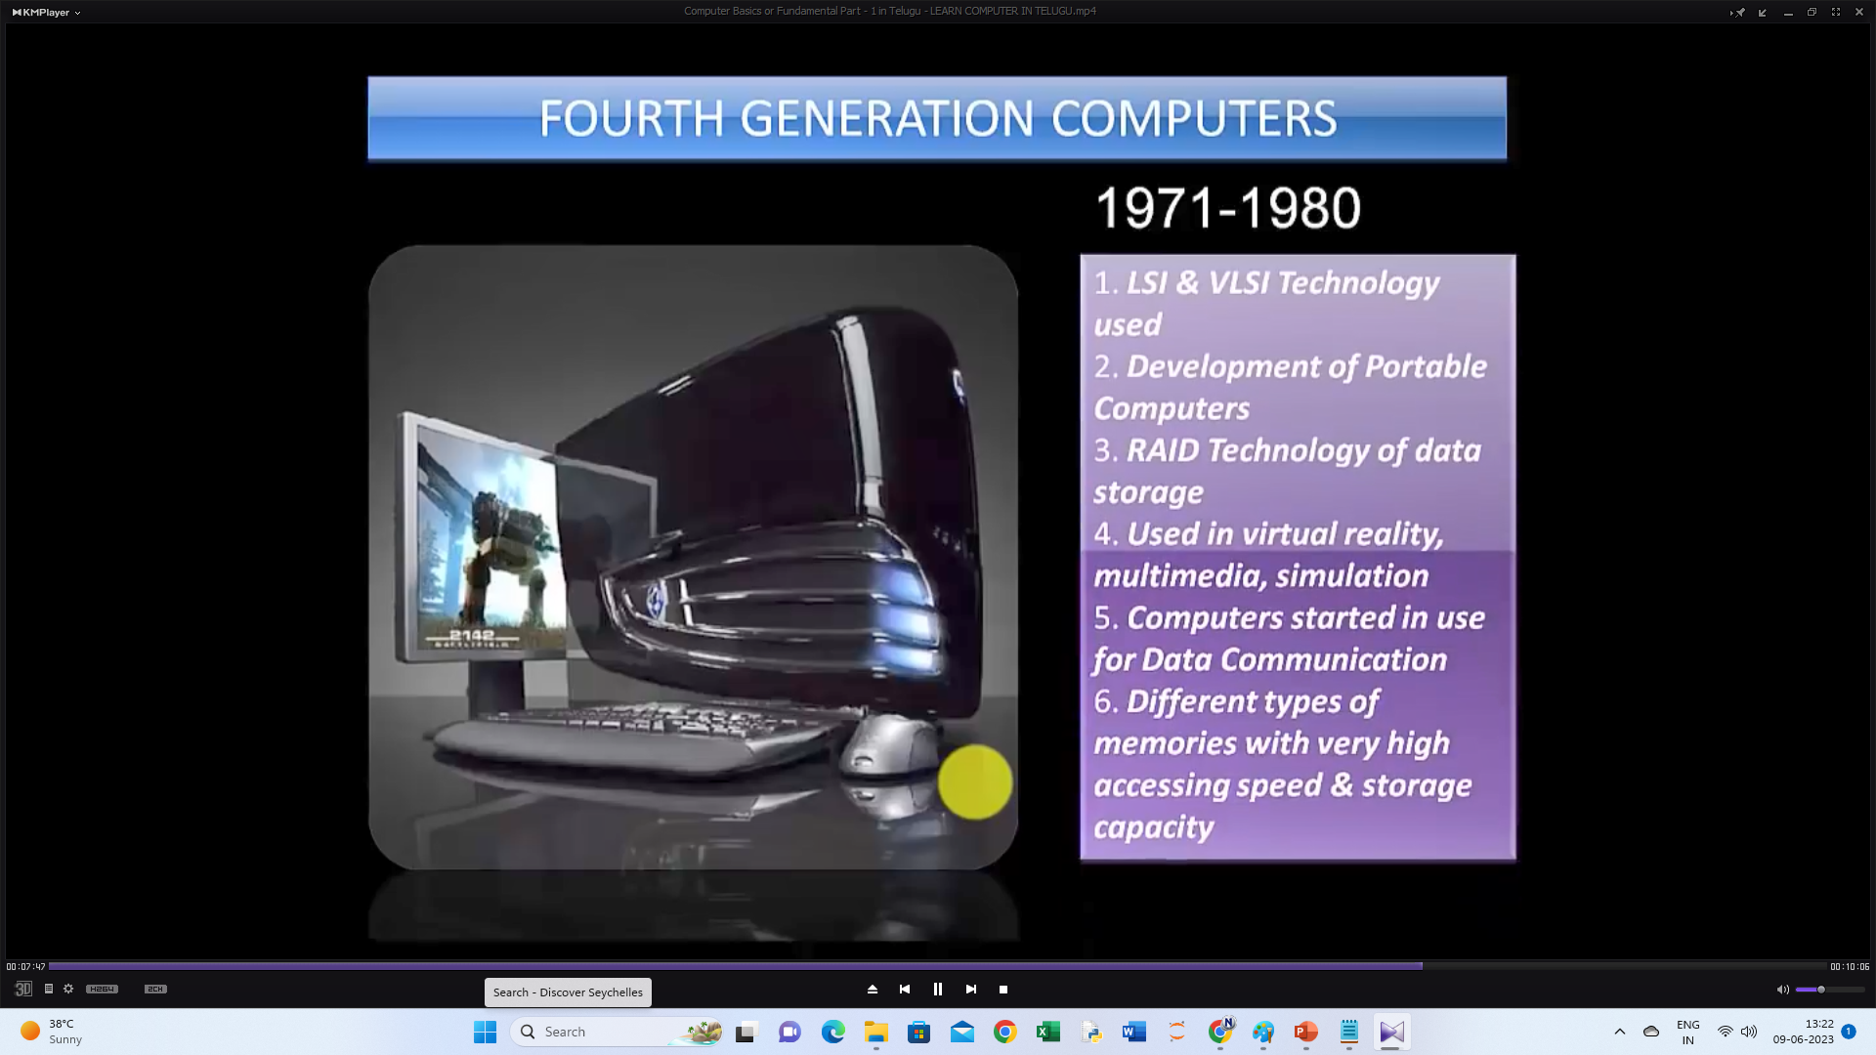

Slide 12
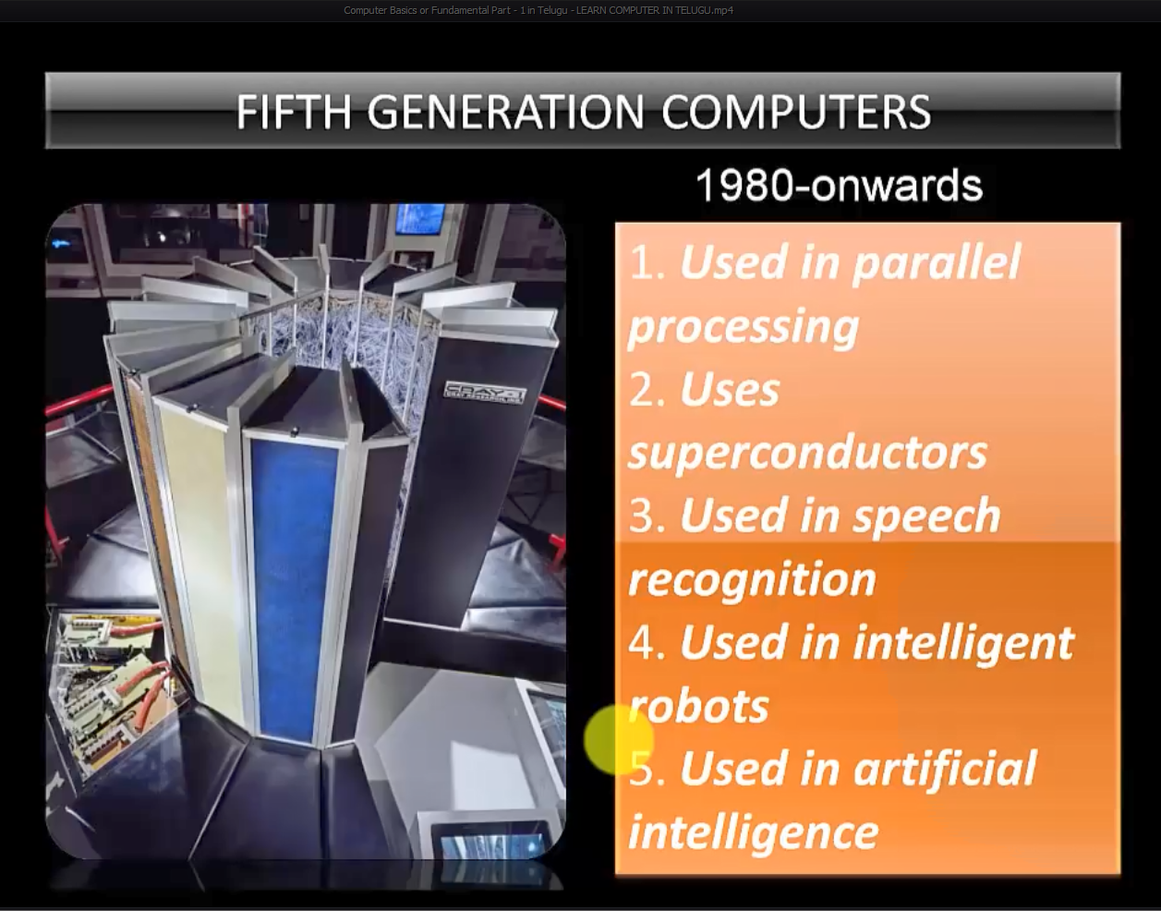

Slide 13
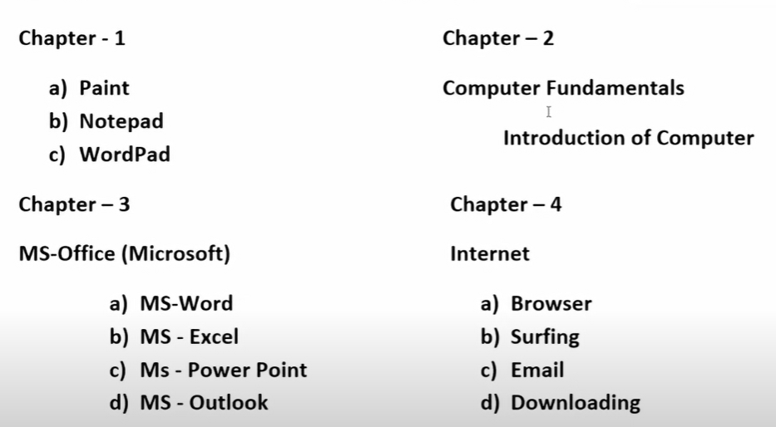

Slide 14
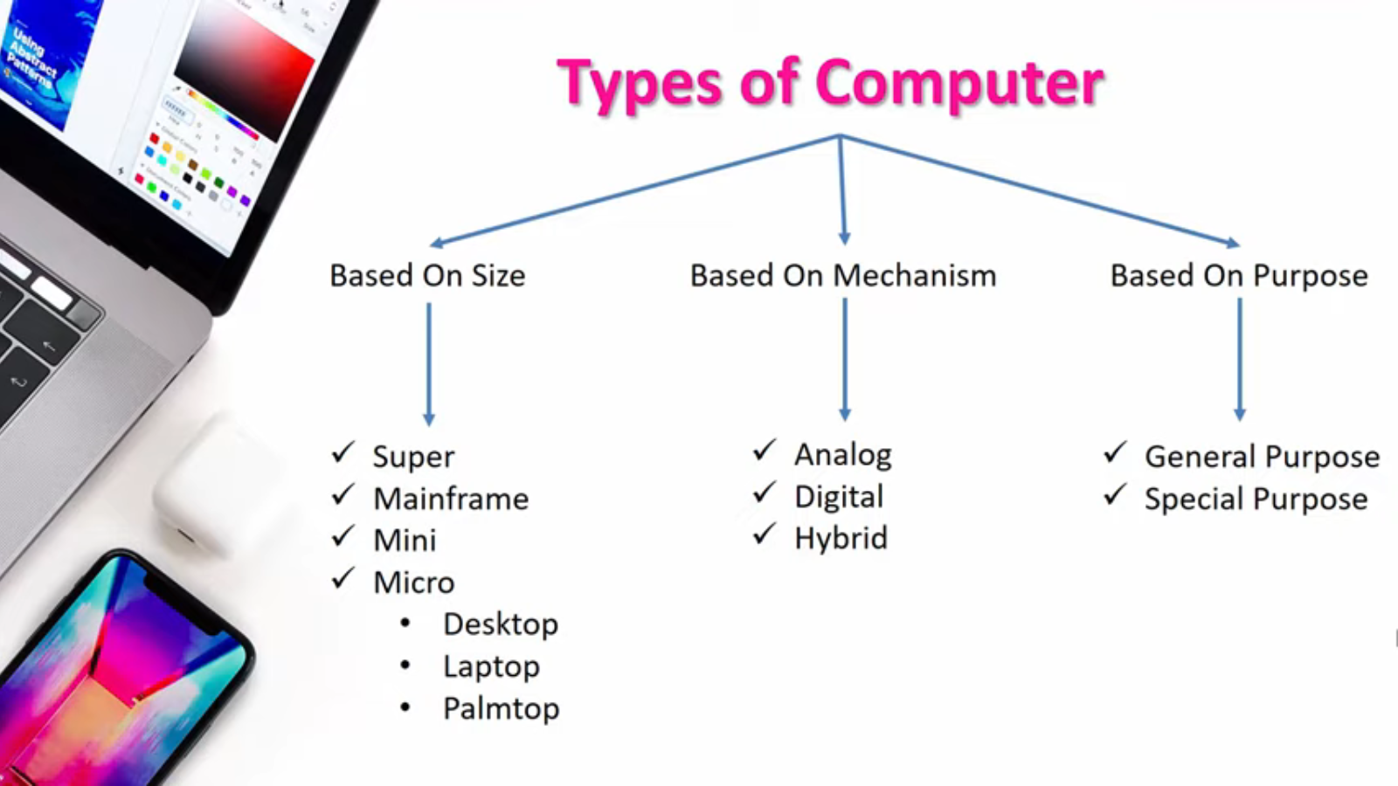
Types Of Computer

Slide 15
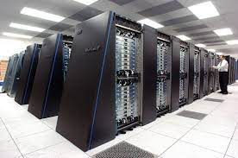
SUPER COMPUTER
• They are very fast and powerful machines.
Run at the speed of 10MIPS(million instructions Perl second).
Very expensive
Not used for general applications.
Examples : Cray and CDC Cyber.

Slide 16
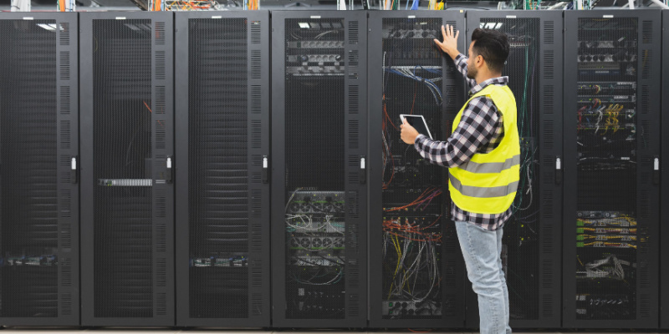
Mainframe Computer
A mainframe is defined as a large, powerful computer typically used for complex calculations and data processing tasks. It can connect to multiple end clients simultaneously so that several users can access different applications and processes running on the mainframe concurrently without impacting performance or security. This article explains how mainframes work and discusses their importance, even in the age of cloud computing

Slide 17
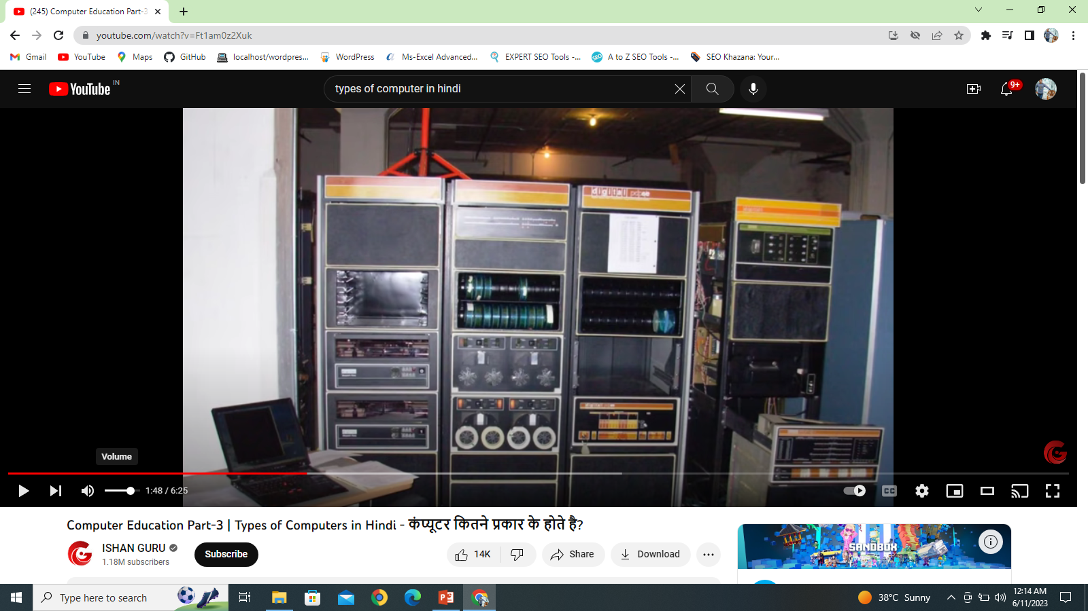
MINI COMPUTER
• They were developed in the 1960's resulting from
advances in microchip technology.
Smaller and less expensive than mainframe computers,
Run at several MIPS and can support 5-20 users.
Low cost and high performance.

Slide 18
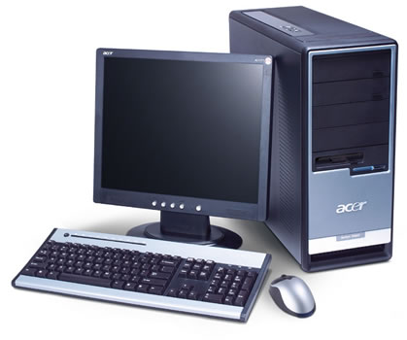
MICRO COMPUTER
They were invented in the 1970's
Used for home computing
Dedicated data processing workstations.
Advances in technology have improved microcomputer
capacities, resulting in the explosive growth of personal
computers in industry.
Micro Computer include :
— Desktop
— Laptop
— Palmtop

Slide 19
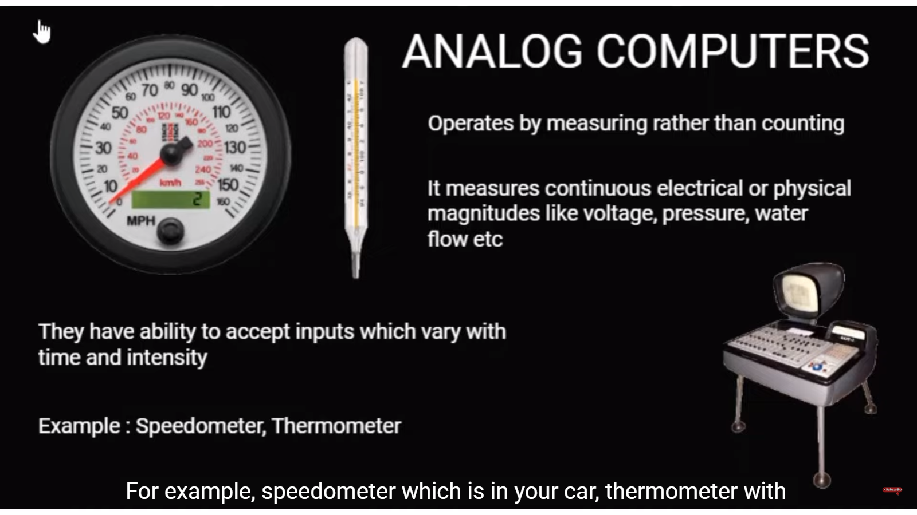

Slide 20
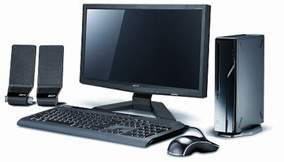
Digital Computer
digital computer, any of a class of devices capable of solving problems by processing information in discrete form. It operates on data, including magnitudes, letters, and symbols, that are expressed in binary code—i.e., using only the two digits 0 and 1

Slide 21

A hybrid computer
A hybrid computer is a combination of digital and analog computers and it combines the best features of both types of computers.
- For example a petrol pump contains a processor that converts fuel flow measurement into quantity and price.
- Hybrid computer is used in hospitals to measure the heartbeat of the patient.
- Hybrid computers are also used in scientific applications or in controlling industrial processes.

Slide 22
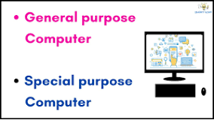
A general purpose computer
A general purpose computer is a computer that is designed to be able to carry out many different tasks. Desktop computers and laptops are examples of general purpose computers. Among other things, they can be used to: access the internet

Slide 23
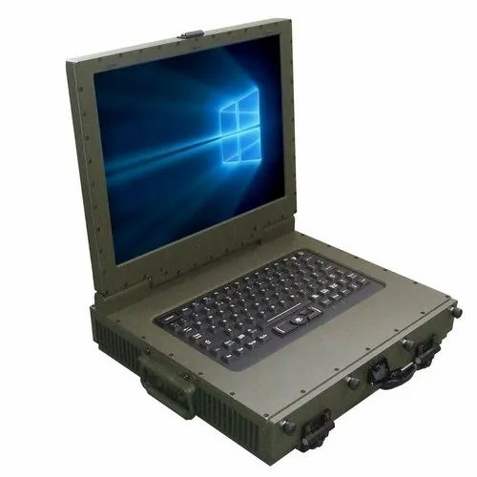
SPECIAL
As they are costly, users cannot afford to purchase them ad are also unavailable in the local computer market.
A special-purpose computer is a computer that is specifically designed for a specific task or application.

